Slide 1
内容设置：
Petri Nets
Petri Nets 基本概念及理论
Applications-Cluster Tools in Semiconductor Manufacturing;
优化方法
线性规划
整数规划
计算智能
模拟退火（SA）；
遗传算法（GA）;
变邻域搜索（VNS）;
粒子群算法（PSO）；
Applications-Cluster Tools in Semiconductor Manufacturing
Applications-Automotive Glass Manufacturing Systems
学习算法
聚类
逻辑回归(重点梯度下降)
神经网络
Applications-Wafer Quality Prediction for Etching Tools in Semiconductor Manufacturing

Slide 2
Petri net
ZhiWu Li and MengChu Zhou, “Deadlock Resolution in Automated Manufacturing Systems: a novel petri net approach,” 2009.
YuFeng Chen and ZhiWu Li, “Optimal Supervisory Control of Automated Manufacturing Systems,” 2013.

Slide 3
Petri nets
1
Process A
Process B
Request Resource
R1
R1
R2
Request Resource
R2
assign
assign
Request Resource
R2(block)
Request Resource
R1(block)

Slide 4
Petri nets
1
Petri nets (Wikipedia, online) were introduced by Carl. Adam. Petri in 1962 in his doctoral dissertation for the purposes of describing chemical processes. Since then, Petri net have been widely studied and developed by researchers and engineers in manufacturing and automations areas. Petri nets can model concurrent systems and their behavior with a mathematical formalism.

Slide 5
Petri nets
1
Definition 1.1 A generalized Petri net is a 4-tuple N = (P, T, F, W) where
P is a set of places;
T is a set of transitions with P ∪ T ≠ ∅ and P ∩ T = ∅;
F ⊆ (P × T) ∪ (T × P) is called a flow relation of the net, represented by arcs with arrows from places to transitions or from transitions to places; and
W: (P × T) ∪ (T × P) →ℕ is a mapping that assigns a weight to an arc: W(x, y) > 0 if (x, y) ∈ F, and W(x, y) = 0 otherwise, where x, y ∈ P ∪ T.
Example: N=(P, T, F, W)
P ={p₁, p₂, c₁, c₂, B};
T ={t₁, t₂, t₃, t₄};
F ={(p₁, t₁), (t₁, p₂), (p₂, t₂),…};
W(p₁, t₁) = W(t₁, p₁) =…= 1;
place
transition
token
arc

Slide 6
Basic structure of the Petri net model
1.1
Notes:
（1） 顺序结构： 如图 2.1（a） 所示。 顺序关系是最直接的因果关系， 变迁t2 的发生条件是变迁t1先发生。
（2） 并发结构： 如图 2.1（b） 所示。 并发关系表明事件之间并没有有向弧组成的路径连接。 在图中，变迁t1， t2 和 t3可以同时发生，相互之间没有影响。
据唯一的共享的资源， 导致其它的两个变迁不能发生。 （4） 同步结构： 如图 2.1（d） 所示。 同步结构反映了事件的发生对于一个或者多个资源的依赖性。 变迁t1只有在几个资源同时具备的情况下才可以发生。 （5） 合并结构： 如图 2.1（e） 所示。 合并结构反映了多个事件对于同一资源产生的影响。 在图中，变迁t1， t2 和 t3的发生都会影响同一个资源 （6） 混惑结构： 如图 2.1（e） 所示。 混惑结构表示的是一种并发和冲突共存的状态。 在图中， t1和 t3并发， t1和 t2 、 t2 和 t3均冲突。 两个冲突只要消解一个，让t1或 者 t3发生， 则另一个冲突也随之消失，因为t2 不再具有发生权。

Slide 7
Formal Definitions
1.1
Example 1.1 Fig 1.1 shows a simple Petri net with P = {p₁–p₅}, T = {t₁–t₃}, F = {(p₁, t₁), (t₃, p₁), (p₂, t₂), (t₁, p₂), (p₃, t₃), (t₂, p₃), (p₄, t₂), (t₃, p₄), (p₅, t₁), (p₅, t₂), (t₃, p₅)}, W(p₁, t₁) = W(t₃, p₁) = W(p₂, t₂) = W(t₁, p₂) = W(p₃, t₃) = W(t₂, p₃) = W(p₄, t₂) = W(t₃, p₄) = W(p₅, t₁) = 1, W(p₅, t₂) = 2, and W(t₃, p₅) = 3. Places are graphically represented by circles and transitions are represented by boxes. It is clear that the net is not ordinary because of the multiplicity of arcs(p₅, t₂) and (t₃, p₅).
Notes:
（1） 顺序结构： 如图 2.1（a） 所示。 顺序关系是最直接的因果关系， 变迁t2 的 发生条件是变迁t1先发生。
（2） 并发结构： 如图 2.1（b） 所示。 并发关系表明事件之间并没有有向弧组成 的路径连接。 在图中，变迁t1， t2 和 t3可以同时发生，相互之间没有影响。
（3） 冲突结构： 如图 2.1（c） 所示。 冲突时由于共享资源的短缺产生的，共享 资源的事件中只有一个可以发生。在图中，变迁 t1， t2 和 t3 中任何一个的发生都将占 据唯一的共享的资源， 导致其它的两个变迁不能发生。 （4） 同步结构： 如图 2.1（d） 所示。 同步结构反映了事件的发生对于一个或者 多个资源的依赖性。 变迁t1只有在几个资源同时具备的情况下才可以发生。 （5） 合并结构： 如图 2.1（e） 所示。 合并结构反映了多个事件对于同一资源产 生的影响。 在图中，变迁t1， t2 和 t3的发生都会影响同一个资源。 （6） 混惑结构： 如图 2.1（e） 所示。 混惑结构表示的是一种并发和冲突共存的 状态。 在图中， t1和 t3并发， t1和 t2 、 t2 和 t3均冲突。 两个冲突只要消解一个，让t1或 者 t3发生， 则另一个冲突也随之消失，因为t2 不再具有发生权。

Slide 8
Formal Definitions
1.2
Example 1.2 A simple Petri net is shown in Fig. 1.2, where P ={p₁-p₅}, T ={t₁-p₄}, F = {(p₁, t₁), (t₁, p₂), (p₂, t₄), (t₄, p₁), (t₁, p₃), (p₃, t₂), (t₂, p₄), (p₄, t₃), (p₃, t₃), (t₃, p₅), (p₅, t₄)}, W(p₁, t₁) = W(t₄, p₁) = W(t₁, p₃) = W(p₃, t₂) = W(t₂, p₄) = W(p₄, t₃) = W(p₃, t₃)= W(t₃, p₅) = W(p₅, t₄) = 1, W(t₁, p₂) = W(p₂, t₄) = 2. Places and transitions are graphically represented by circles and boxes, respectively.
Fig 1.2 A Petri net example.

Slide 9
Formal Definitions
1.2
Definition 1.2 A Petri net N = (P, T, F, W) is said to be ordinary if ∀(x, y) ∈ F, W(x, y) = 1. N is said to be generalized if ∃(x, y) ∈ F, W(x, y) > 1.
Example 1.3 A Petri net shown in Fig. 1.2 is generalized since W(t₁, p₂) = W(p₂, t₄) = 2. An ordinary net is shown in Fig. 1.3 since the weight of each arc is equal to one.
Fig 1.3 An ordinary Petri net.

Slide 10
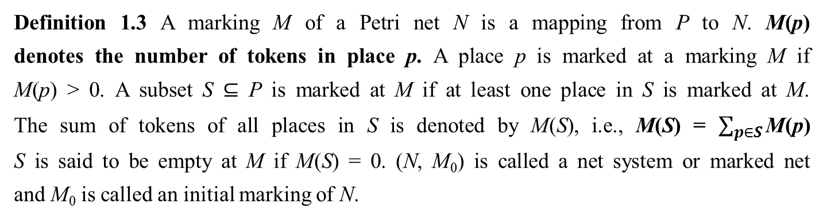
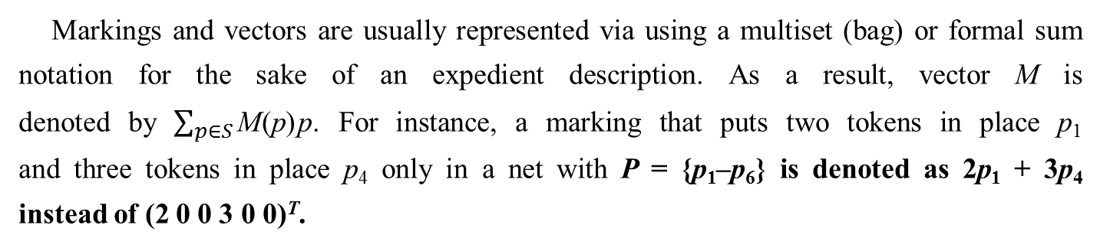
Formal Definitions
1.2
Definition 1.3 A marking M of a Petri net N is a mapping from P to N. M(p) denotes the number of tokens in place p. A place p is marked at a marking M if M(p) > 0. A subset S ⊆ P is marked at M if at least one place in S is marked at M. The sum of tokens of all places in S is denoted by M(S), i.e., M(S) = $\sum_{p∈S}{\text{M}\text{(}\text{p}\text{)}}$ S is said to be empty at M if M(S) = 0. (N, M₀) is called a net system or marked net and M₀ is called an initial marking of N.
Markings and vectors are usually represented via using a multiset (bag) or formal sum notation for the sake of an expedient description. As a result, vector M is denoted by $\sum_{p∈S}{\text{M}\text{(}\text{p}\text{)}}$p. For instance, a marking that puts two tokens in place p₁ and three tokens in place p₄ only in a net with P = {p₁–p₆} is denoted as 2p₁ + 3p₄ instead of (2 0 0 3 0 0)^{T}.

Slide 11
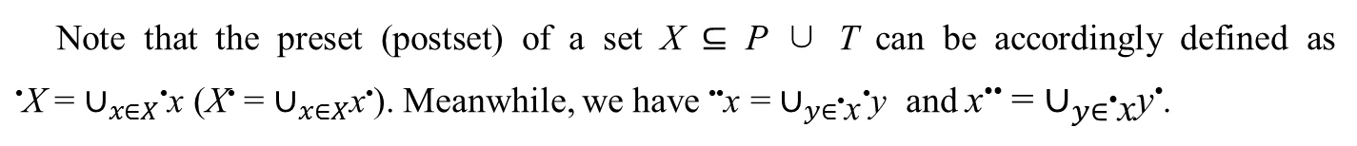
Formal Definitions
1.2
Definition 1.4 The preset (postset) of a node x ∈ P ∪ T is defined as •x = {y ∈ P∪T|(y, x) ∈ F} (x• = {y ∈ P∪T|(x, y) ∈ F}).
Note that the preset (postset) of a set X ⊆ P ∪ T can be accordingly defined as •X = $∪_{x∈X}$•x (X• = $∪_{x∈X}$x•). Meanwhile, we have ••x = $∪_{y∈\text{•}\text{x}}$•y and x•• = $∪_{y∈\text{•}\text{x}}$y•.

Slide 12
Formal Definitions
1.2
Example 1.5 For the Petri net in Fig. 1.2, it is clear that •p₁ = {t₄}, p₁• = {t₁}, •p₂ = {t₁}, p₂• = {t₄}, •p₃ = {t₁}, p₃• = {t₂, t₃}, •p₄ = {t₂}, p₄• = {t₃}, •p₅ = {t₃}, and p₅• = {t₄}. Moreover, •{p₁, p₂, p₃} = {t₁, t₄} and {p₁, p₂, p₃}• = {t₁, t₂, t₃, t₄}.

Slide 13
Formal Definitions
1.2
Definition 1.5 A transition t ∈ T is enabled at a marking M if ∀p ∈•t, M(p) ≥ W(p, t). This fact is denoted as M[t⟩. Firing it yields a new marking M′ such that ∀p ∈ P, M′(p) = M(p) - W(p, t) + W(t, p), denoted by M[t⟩M′. M′ is called an immediately reachable marking from M. Marking M′′ is said to be reachable from M if there exists a sequence of transitions σ = t₀t₁ ···t_{n} and markings M₁, M₂,···, and M_{n} such that M[t₀⟩M₁[t₁⟩M₂ ··· M_{n}[t_{n}⟩M′′ holds. The set of markings reachable from M in N is called the reachability set of Petri net (N, M) and denoted as R(N, M).
Example：
t

Slide 14
Formal Definitions
1.2
Example 1.6 Fig. 1.4a, t₁ is enabled at initial marking M₀ = 3p₁ + 2p₄ + 3p₅ since •t₁ = {p₁, p₅}, M₀(p₁) = 3 > W(p₁, t₁) = 1, and M₀(p₅) = 3 > W(p₅, t₁) = 1. Firing t₁ leads to M₁ with M₁(p₁) = M₀(p₁) - W(p₁, t₁)+W(t₁, p₁) = 2, M₁(p₂) = M₀(p₂) - W(p₂, t₁) + W(t₁, p₂) = 1, M₁(p₃) = M₀(p₃) - W(p₃, t₁) + W(t₁, p₃) = 0, M₁(p₄) = M₀(p₄) - W(p₄,t₁) + W(t₁, p₄) = 2, and M₁(p₅) = M₀(p₅) - W(p₅, t₁) + W(t₁, p₅) = 2, as shown in Fig 1.4b. In the same way, M₂, M₃, and M₄ can be obtained, respectively.

Slide 15
Formal Definitions
1.2
Fig 1.4 A Petri net example

Slide 16
Formal Definitions
1.2
Definition 1.6 A Petri net (N, M₀) is safe if ∀M ∈ R(N, M₀), ∀p ∈ P, M(p) ≤ 1 is true. It is bounded if ∃k ∈ ℕ⁺, ∀M ∈ R(N, M₀), ∀p ∈ P, M(p) ≤ k. It is said to be unbounded if it is not bounded. A net N is structurally bounded if it is bounded for any initial marking.
Definition 1.7 A net N = (P, T, F, W) is pure (self-loop free) if ∀x, y ∈ P ∪ T, W(x, y) > 0 implies W(y, x) = 0

Slide 17
Formal Definitions
1.2
Example 1.7 The Petri net in Fig. 1.2 is not safe since p₂ can hold two tokens when t₁ fires at the initial marking. The Petri net shown in Fig. 1.3 is safe. Both net models are bounded, structurally bounded, and pure.
Fig. 1.2
Fig. 1.3

Slide 18
Formal Definitions
1.2
Definition 1.8 The output and input incidence matrices of a net are defined as Post and Pre, respectively. Post: P × T →ℕ is a mapping that assigns weights to direct arcs from transitions in T to places in P; Pre : T × P →ℕ is a mapping that assigns weights to direct arcs from places in P to transitions in T; The incidence matrix of a net is defined as [N] = Post − Pre where Post(p, t) = W(t, p), Pre(p, t) = W(p, t). For a place p (transition t), its incidence vector, a row (column) in [N], is denoted by [N](p, ·) ([N](·, t)).
A pure net N = (P, T, F, W) and its incidence matrix [N] have one-to-one relationship. However, for a non-pure net, its incidence matrix cannot represent self-loops. That is to say, two nets have the same incidence matrix but may have different net structures.

Slide 19
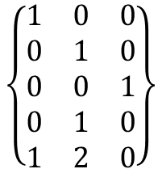
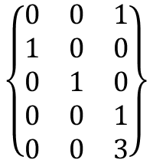
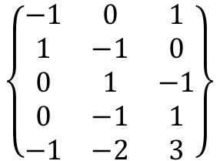
Formal Definitions
1.2
Example 1.8 For the Petri net in Fig. 1.4a, we have
t₁ t₂ t₃
t₁ t₂ t₃
p₁
p₂
p₃
p₄
p₅
p₁
p₂
p₃
p₄
p₅
$$\left\{\begin{matrix}\begin{aligned}0 \\ 1 \\ 0 \\ 0 \\ 0\end{aligned} & \begin{aligned}0 \\ 0 \\ 1 \\ 0 \\ 0\end{aligned} & \begin{aligned}1 \\ 0 \\ 0 \\ 1 \\ 3\end{aligned}\end{matrix}\right\}$$
$$\left\{\begin{matrix}\begin{aligned}1 \\ 0 \\ 0 \\ 0 \\ 1\end{aligned} & \begin{aligned}0 \\ 1 \\ 0 \\ 1 \\ 2\end{aligned} & \begin{aligned}0 \\ 0 \\ 1 \\ 0 \\ 0\end{aligned}\end{matrix}\right\}$$
Post =
Pre =
t₁ t₂ t₃
p₁
p₂
p₃
p₄
p₅
$$\left\{\begin{matrix}\begin{aligned}−1 \\ 1 \\ 0 \\ 0 \\ −1\end{aligned} & \begin{aligned}0 \\ −1 \\ 1 \\ −1 \\ −2\end{aligned} & \begin{aligned}1 \\ 0 \\ −1 \\ 1 \\ 3\end{aligned}\end{matrix}\right\}$$
Post – Pre = [N] =

Slide 20
Formal Definitions
1.2
Definition 1.9 Given a Petri net (N, M₀), t ∈ T is live at M₀ if ∀M ∈ R(N, M₀), ∃M′ ∈ R(N, M), M′[t⟩. (N, M₀) is dead at M₀ if ∄t ∈ T, M₀[t⟩. (N, M₀) is deadlock-free (weakly live or live-lock) if ∀M ∈ R(N, M₀), ∃t ∈ T, M[t⟩.

Slide 21
Formal Definitions
1.2
Example 1.9: The net shown in Fig. 1.5a is deadlock-free since transitions t₁ and t₂ are live. The net in Fig. 1.4e is dead since no transition is enabled under the current marking.

Slide 22
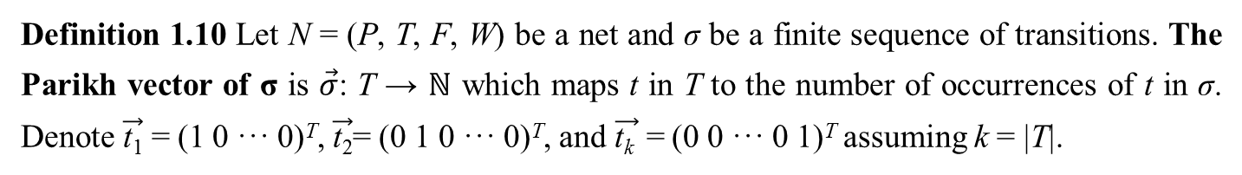

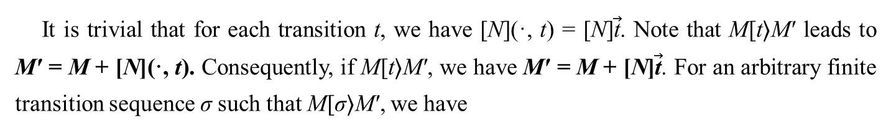
Formal Definitions
1.2
Definition 1.10 Let N = (P, T, F, W) be a net and σ be a finite sequence of transitions. The Parikh vector of σ is $\vec{σ}$: T → ℕ which maps t in T to the number of occurrences of t in σ. Denote $\vec{\text{t}\text{1}}$ = (1 0 ··· 0)^{T}, $\vec{\text{t}\text{2}}$= (0 1 0 ··· 0)^{T}, and $\vec{\text{t}\text{k} }$ = (0 0 ··· 0 1)^{T} assuming k = |T|.
It is trivial that for each transition t, we have [N](·, t) = [N]$\vec{\text{t}}$. Note that M[t⟩M′ leads to M′ = M + [N](·, t). Consequently, if M[t⟩M′, we have M′ = M + [N]$\vec{\text{t}}$. For an arbitrary finite transition sequence σ such that M[σ⟩M′, we have
M′ = M + [N]$\vec{\text{σ}}$
(1.1)

Slide 23
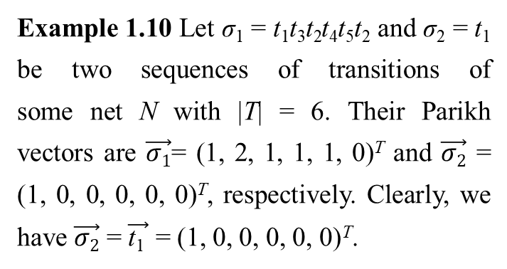
Formal Definitions
1.2
Example 1.10 Let σ₁ = t₁t₃t₂t₄t₅t₂ and σ₂ = t₁ be two sequences of transitions of some net N with |T| = 6. Their Parikh vectors are $\vec{σ1}$= (1, 2, 1, 1, 1, 0)^{T} and $\vec{σ2}$ = (1, 0, 0, 0, 0, 0)^{T}, respectively. Clearly, we have $\vec{σ2}$ = $\vec{\text{t}\text{1} }$ = (1, 0, 0, 0, 0, 0)^{T}.

Slide 24


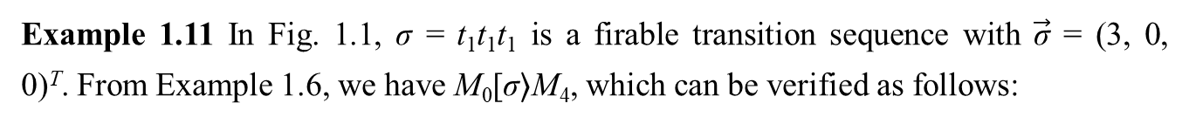
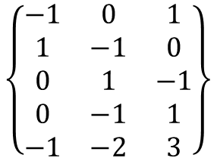









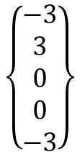
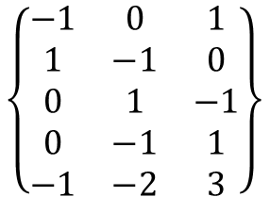
Formal Definitions
1.2
Example 1.11 In Fig. 1.1, σ = t₁t₁t₁ is a firable transition sequence with $\vec{\text{σ}}$ = (3, 0, 0)^{T}. From Example 1.6, we have M₀[σ⟩M₄, which can be verified as follows:
$$\left\{\begin{aligned}3 \\ 0 \\ 0 \\ 2 \\ 3\end{aligned}\right\}$$
$$\left\{\begin{matrix}\begin{aligned}−1 \\ 1 \\ 0 \\ 0 \\ −1\end{aligned} & \begin{aligned}0 \\ −1 \\ 1 \\ −1 \\ −2\end{aligned} & \begin{aligned}1 \\ 0 \\ −1 \\ 1 \\ 3\end{aligned}\end{matrix}\right\}$$
$$\left\{\begin{aligned}3 \\ 0 \\ 0 \\ 2 \\ 3\end{aligned}\right\}$$
$$\left\{\begin{aligned}−3 \\ 3 \\ 0 \\ 0 \\ −3\end{aligned}\right\}$$
$$\left\{\begin{aligned}0 \\ 3 \\ 0 \\ 2 \\ 0\end{aligned}\right\}$$
$$\left\{\begin{matrix}3 \\ 0 \\ 0\end{matrix}\right\}$$
σ = t₁t₁t₁:
M₀ + [N]$\vec{\text{σ}}$ =
+
=
+
=
= M₄
$$\left\{\begin{aligned}3 \\ 0 \\ 0 \\ 2 \\ 3\end{aligned}\right\}$$
$$\left\{\begin{matrix}\begin{aligned}−1 \\ 1 \\ 0 \\ 0 \\ −1\end{aligned} & \begin{aligned}0 \\ −1 \\ 1 \\ −1 \\ −2\end{aligned} & \begin{aligned}1 \\ 0 \\ −1 \\ 1 \\ 3\end{aligned}\end{matrix}\right\}$$
$$\left\{\begin{aligned}3 \\ 0 \\ 0 \\ 2 \\ 3\end{aligned}\right\}$$
$$\left\{\begin{aligned}0 \\ 0 \\ 0 \\ 0 \\ 0\end{aligned}\right\}$$
$$\left\{\begin{aligned}3 \\ 0 \\ 0 \\ 2 \\ 3\end{aligned}\right\}$$
$$\left\{\begin{matrix}1 \\ 1 \\ 1\end{matrix}\right\}$$
σ = t₁t₂t₃:
M₀ + [N]$\vec{\text{σ}}$ =
+
=
+
=
= M₀

Slide 25
Structural Invariants
1.3
One important feature of Petri nets is that their structural properties can be obtained by linear algebraic techniques. These properties that depend on only the topological structure of a Petri net and are independent of the initial marking are called invariants. Invariants are an important means for analyzing the behavior of a Petri net from a structural viewpoint.

Slide 26
Structural Invariants
1.3
Definition 1.11 A P-vector is a column vector I : P → ℤ indexed by P and a T- vector is a column vector J : T → ℤ indexed by T , where ℤ is the set of integers.
We denote column vectors where every entry equals 0(1) by 0(1). I^{T} and [N]^{T} are the transposed versions of vector I and matrix [N], respectively. A P(T)-vector is non-negative if no element in it is negative.
Definition 1.12: P-vector I is called a P-invariant (place invariant, PI for short) if I ≠ 0 and I^{T}[N] = 0^{T}. T-vector J is called a T-invariant (transition invariant) if J ≠ 0 and [N]J = 0.

Slide 27
Structural Invariants
1.3
Definition 1.13 P-invariant I is a P-semiflow if every element of I is non-negative. ||I|| = {p|I(p) ≠ 0} is called the support of I. I is called a minimal P-invariant if ||I|| is not a superset of the support of any other one and its components are mutually prime.
Theorem 1.1 Let (N, M₀) be a net with P-invariant I and M a reachable marking from M₀. Then
I^{T}M = I^{T}M₀
Property 1.1 If I is a P-semiflow of a net, •||I|| = ||I||•.

Slide 28
Structural Invariants
1.3
Example 1.12 For the Petri net in Fig. 1.6, there are two P-invariants I₁ = (1 1 1 2 0)^{T} and I₂ = (0 1 0 0 1)^{T}, and one T-invariant J₁ = (1 1 1 1)^{T}. We have ||I₁|| = {p₁, p₂, p₃, p₄} and ||I₂|| = {p₂, p₅}. Both I₁ and I₂ are minimal. According to Property 1.1, we also have •||I₁ || = ||I₁||• = {t₁, t₂, t₃, t₄} and •||I₂ || = ||I₂||• = {t₁, t₂}.

Slide 29
Siphon and trap
1.4
Definition 1.14 A nonempty set S ⊆ P is a siphon if •S ⊆ S•. S ⊆ P is a trap if S• ⊆ •S. A siphon (trap) is minimal if there is no siphon (trap) contained in it as a proper subset. A minimal siphon S is said to be strict if •S ⫋ S•.
Property 1.2 Let S₁ and S₂ be two siphons (traps). Then, S₁ ∪ S₂ is a siphon (trap).

Slide 30
Siphon and trap
1.4
Example 1.13 In the Petri net in Fig. 1.6, there is a siphon S = {p₁, p₄} since •S ⊂ S•, where •S = {t₃, t₄} and S• = {t₁, t₃, t₄}. In fact, S is both strict and minimal since •S ⊂ S• and there is no other siphon contained in S as a proper subset.

Slide 31
Siphon and trap
1.4
Corollary 1.1 If I is a P-semiflow, then ||I|| is both a siphon and trap.
Example 1. 14 In the Petri net in Fig. 1.6, S = {p₂, p₅} is both a siphon and trap since •S = S• = {t₁, t₂}.

Slide 32
Siphon and trap
1.4
Property 1.3 Let M∈R(N, M₀) be a marking of net (N, M₀) and S a trap. If M(S ) > 0, then ∀M′ ∈ R(N, M), M′(S ) > 0.
Property 1.4 Let M ∈ R(N, M₀) be a marking of net (N, M₀) and S a siphon. If M(S ) = 0, then ∀M′ ∈ R(N, M), M′(S ) = 0.
Property 1.3 indicates that once a trap is marked at M, it is always marked at any reachable marking from M. Property 1.4 shows that once a siphon is empty at M, it remains empty at any reachable marking from M.

Slide 33
Siphon and trap
1.4
Theorem 1.2 Let (N, M₀) be an ordinary net and Π the set of its siphons. The net is deadlock-free if ∀S ∈ Π, ∀M ∈ R(N, M₀), M(S) > 0.
Definition 1.16 A siphon S is said to be controlled in a net system (N, M₀) if ∀M ∈ R(N, M₀), M(S ) > 0.
Definition 1.17 Let N = (P, T, F, W) be a Petri net with P_{X} ⊆ P and T_{X} ⊆ T. N_{X} = (P_{X},T_{X}, F_{X},W_{X}) is called a subnet generated by P_{X} ∪ T_{X} if F_{X} = F ∩ [(P_{X} × T_{X}) ∪(T_{X} × P_{X})] and ∀ f ∈ F_{X}, W_{X}( f ) = W( f ).

Slide 34
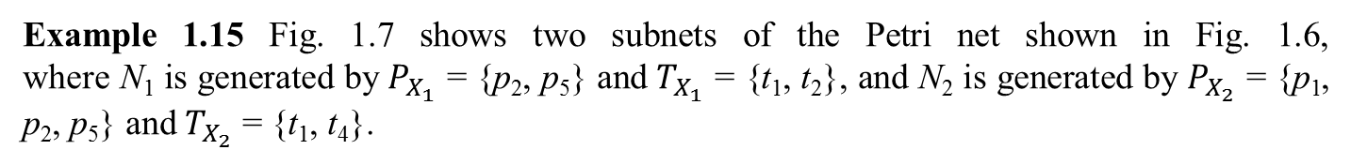
Siphon and trap
1.4
Example 1.15 Fig. 1.7 shows two subnets of the Petri net shown in Fig. 1.6, where N₁ is generated by $P_{X_{1}}$ = {p₂, p₅} and $T_{X_{1}}$ = {t₁, t₂}, and N₂ is generated by $P_{X_{2}}$ = {p₁, p₂, p₅} and $T_{X_{2}}$ = {t₁, t₄}.

Slide 35
Reachability Graph
1.4
The reachability graph of a Petri net can reflect its complete behavior, i.e., it exactly presents the evolution of the net system. Thus, it is important for the control of a Petri net, especially its optimal control. This section shows the analysis of a reachability graph from the viewpoint of deadlock control.

Slide 36
Reachability Graph
1.4
Let G(N, M₀) be the reachability graph of a bounded Petri net. For deadlock control purposes, markings in a reachability graph can be classified into four categories: deadlock, bad, dangerous and good ones.
good marking
dangerous marking
bad marking
deadlock zone
deadlock marking

Slide 37
Reachability Graph
1.4
The set of good and dangerous markings in R(N, M₀), namely M_{L}, should constitute the maximum legal behavior if a supervisor is optimally designed. For a Petri net system (N, M₀), the set of its legal markings is defined as
M_{L} = {M|M ∈ R(N, M₀)∧M₀ ∈ R(N, M)}
G(N, M₀) is split into a deadlock-zone (DZ) and a live-zone (LZ), where the DZ contains deadlock and bad markings and the LZ contains all the legal markings. A first-met bad marking (FBM) is defined as the one within DZ, representing the very first entry from the LZ to the DZ. A mathematical form of the set of first-met bad markings is defined as
M_{FBM} = {M|M in DZ,∃M′ in LZ, t ∈ T, s.t. M′[t⟩M}
Notes:
M4, M8, M9, M13,and M14 are FBMs.

Slide 38
Thanks！

